Slide 1
ABC PHARMACEUTICAL SALES ANALYSIS
BY KHADIJAH IDRIS

Slide 2
Problem summary
ABC Pharmaceutical Company struggles to integrate varying data sources and perform granular analysis hindering its ability to understand sales performance, customer purchasing behavior, optimize product distribution, ultimately resulting in missed opportunities and in efficiencies.
The Project aims at using comprehensive data to uncover hidden insights

Slide 3
OBJECTIVES
Analyze Sales Trends and Customer Behavior
Evaluate Product and Channel Performance
Understand Geographical Impact
Optimize Sales and Product Strategies

Slide 4
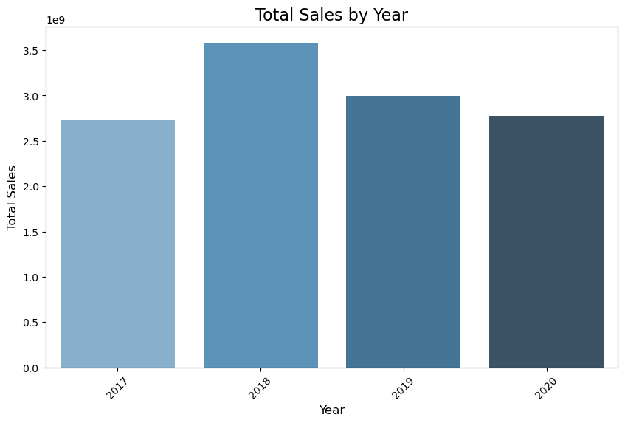
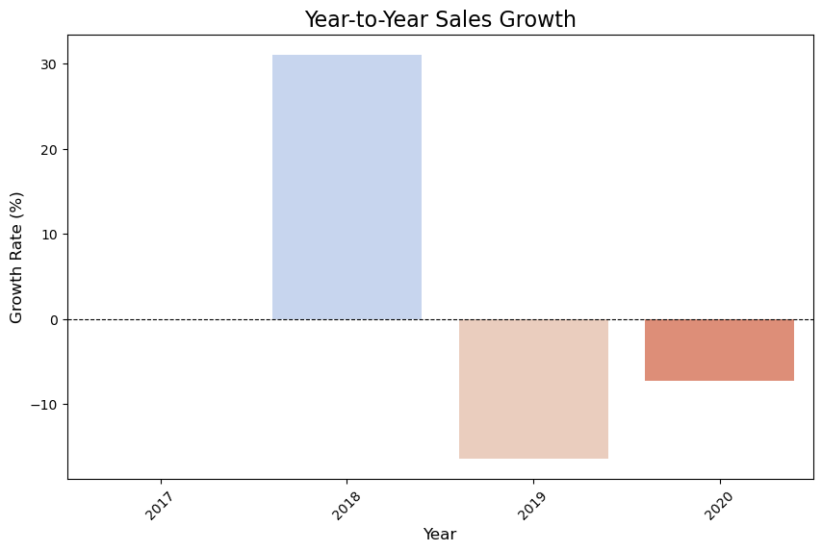
EDA: Sales trend over time

Slide 5
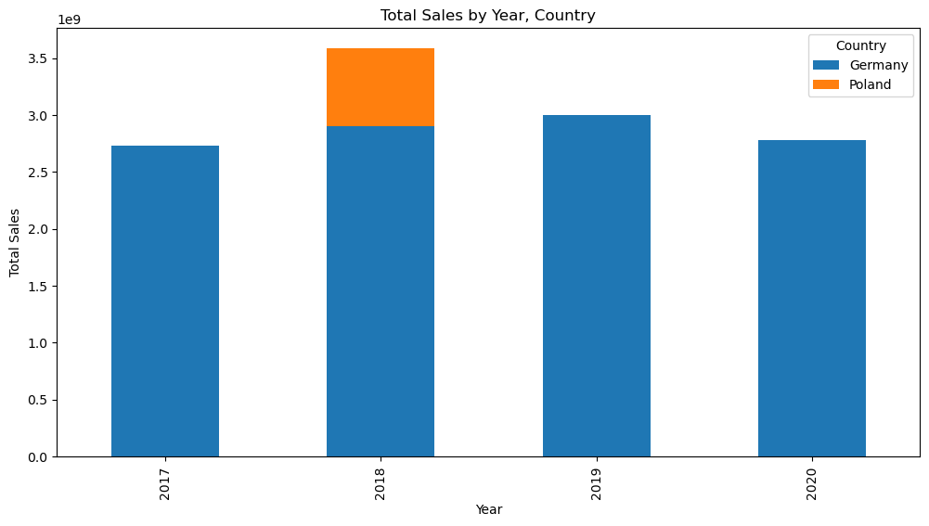
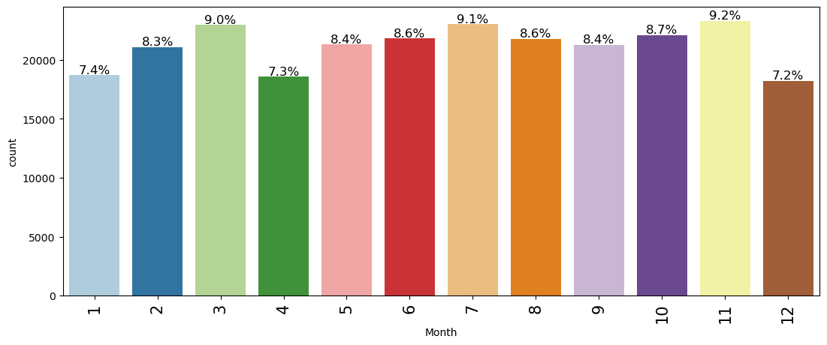
EDA: Sales trend over time

Slide 6
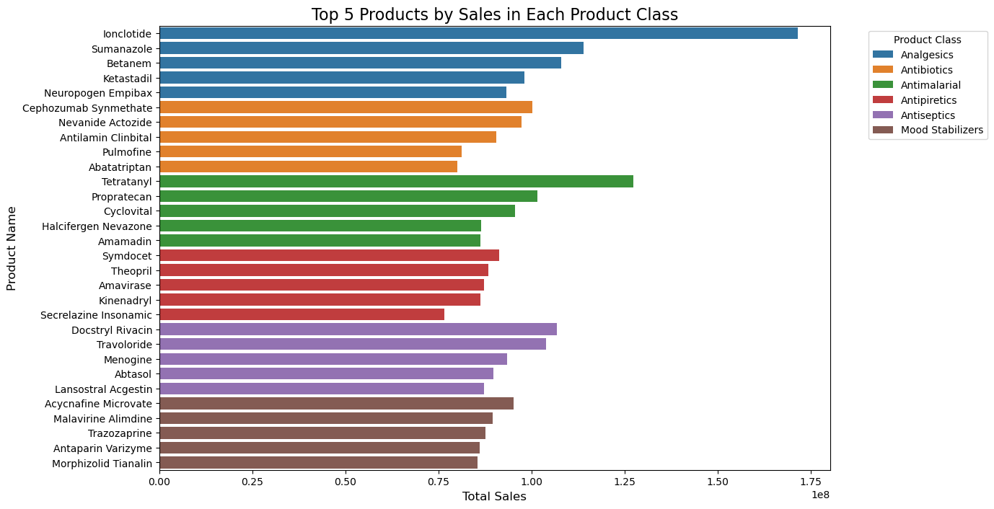
EDA: Product performance

Slide 7
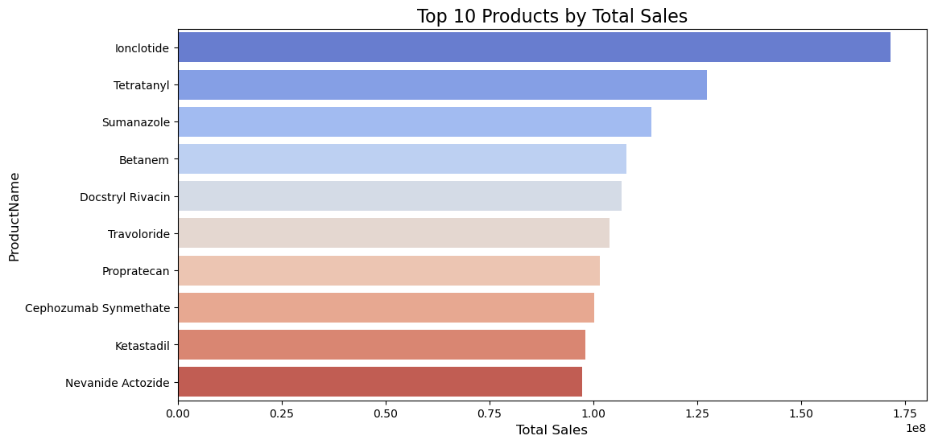
EDA: Product performance

Slide 8
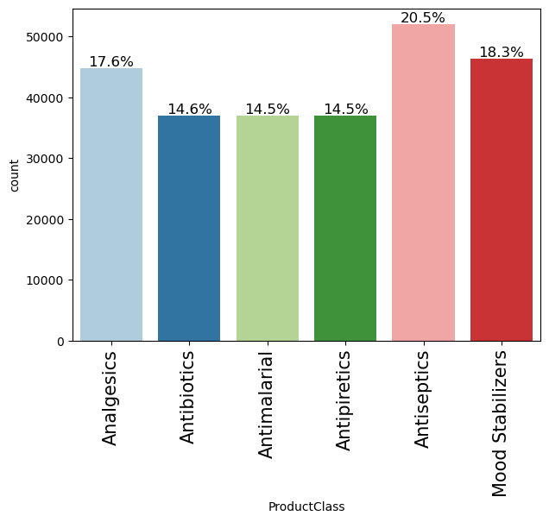
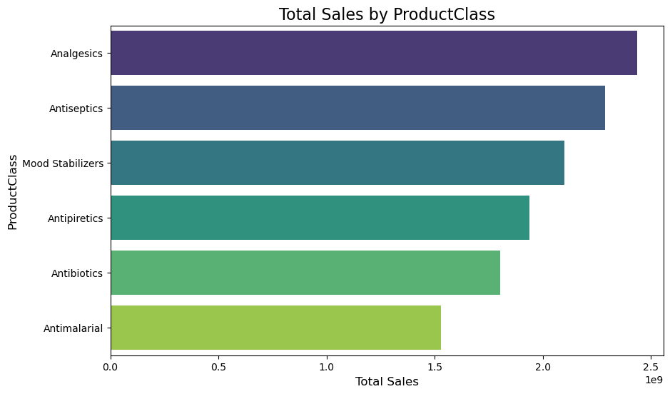
EDA: Product performance

Slide 9
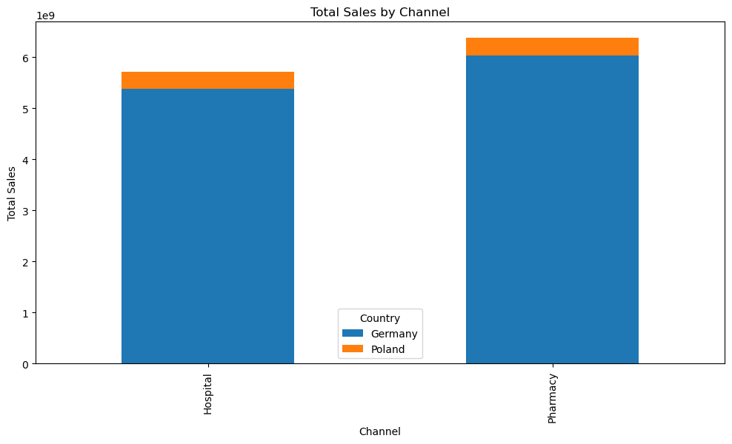
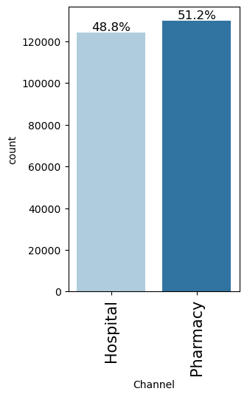
EDA: CHANNEL performance

Slide 10
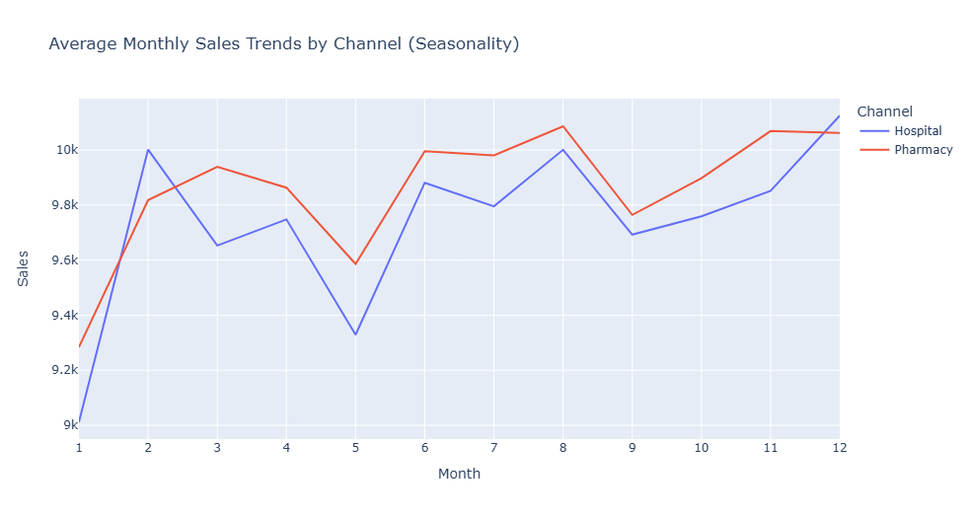
EDA: CHANNEL performance

Slide 11
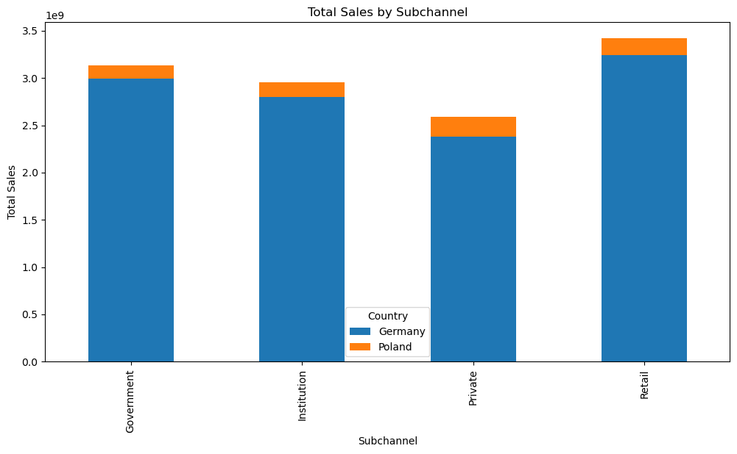
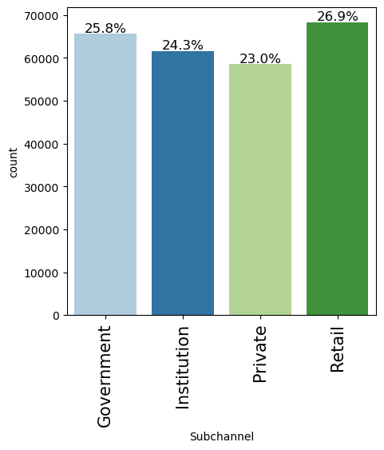
EDA: SubCHANNEL performance

Slide 12
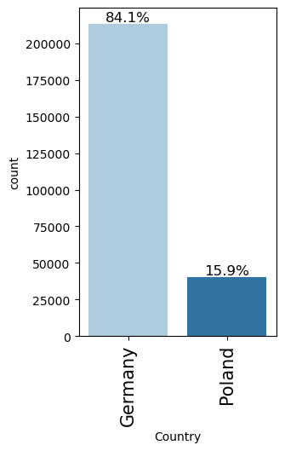
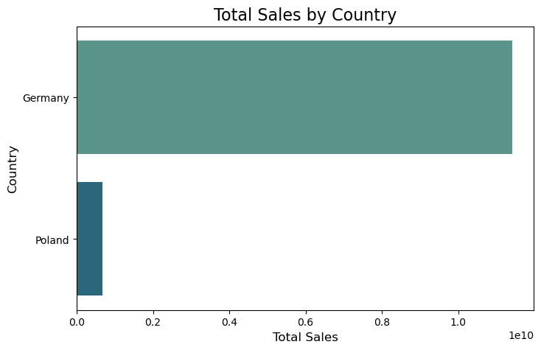
EDA: REGIONAL performance

Slide 13
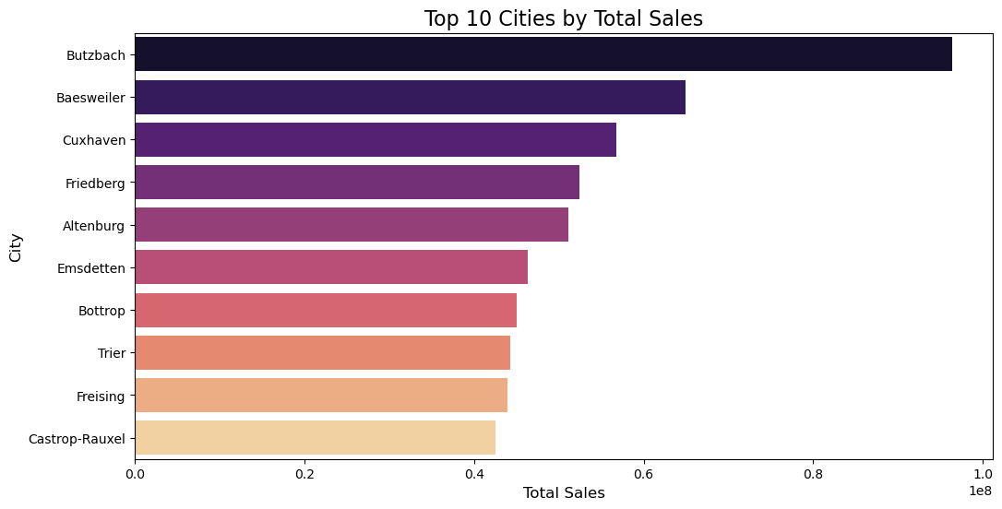
EDA: REGIONAL performance

Slide 14
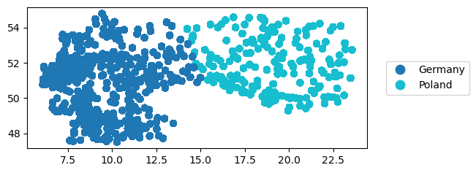
Geospatial analysis
* Here’s a plot showing the geopandas dataframe
* More concentration of sales entries in Germany than in Poland

Slide 15
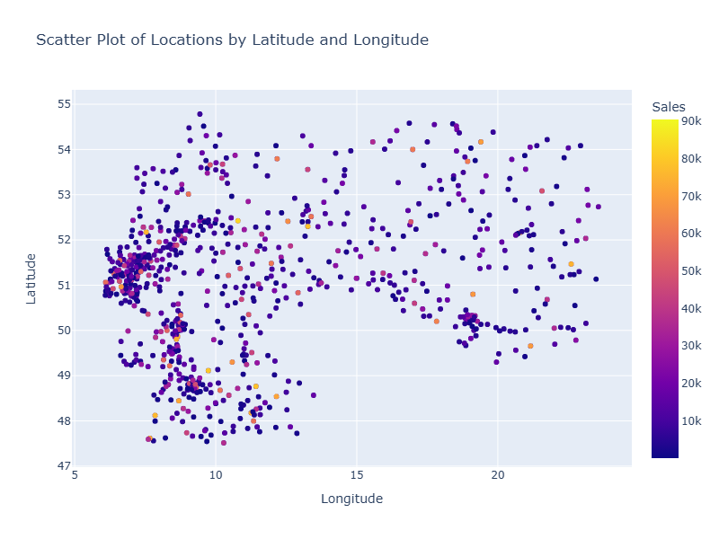
GEOSPATIAL ANALYSIS
* Most sales are between 0 to 10k
*There’s a significantl number of high sales in Germany
*

Slide 16
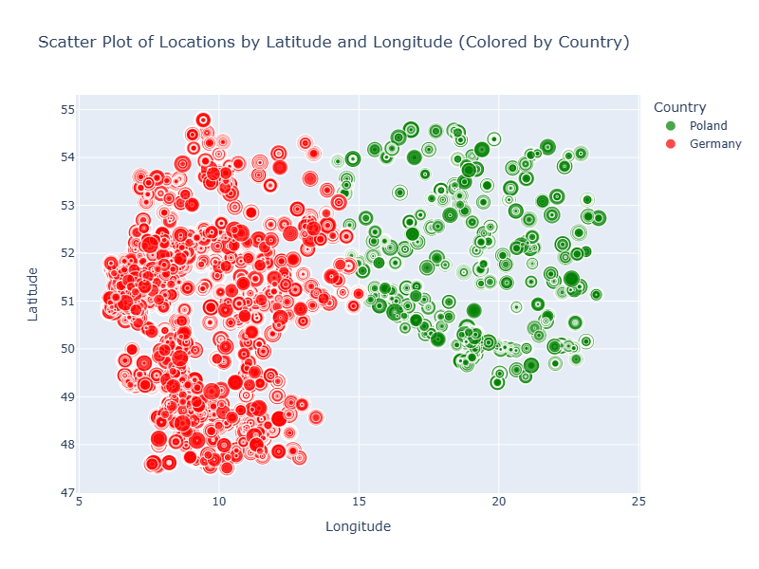
Geospatial analysis
*The point sizes represent the size of sales
*There’s a much larger concentration of huge points in the Germany area

Slide 17
INSIGHTS
Pricing strategies might not be directly influencing sales volume in the business, or other factors (such as demand, marketing efforts, distribution channels, etc.) could be playing a more significant role.
The pharmacy channel is doing significantly better than the hospital channel.
The urban areas, despite typically being the high-potential market due to population density, are not performing as well in terms of sales volume as rural areas. This could be due to a variety of factors, including market saturation, high competition, or logistical challenges.
Business should consider targeted promotions or loyalty programs and marketing campaigns to boost sales in urban areas.

Slide 18
RECOMMENDATIONS
The business should consider focusing on factors other than price to drive sales, such as enhancing marketing campaigns, exploring customer preferences, and improving distribution channels especially in urban areas
Business should also consider other strategies to increase sales, such as bundling products, offering discounts for bulk purchases and improve customer education on products
Business should consider conducting channel-specific analysis to identify the most profitable customer segments and tailor marketing efforts accordingly.
Business can reevaluate the pricing strategy and marketing efforts in urban areas. Urban areas may be oversaturated with competition, and therefore, targeting different value propositions or adjusting pricing strategies could help.
Business should consider targeted promotions or loyalty programs and marketing campaign to boost sales in urban areas.

